Slide 1
Project 4: Time Efficient Ultrasound Localization
Microscopy (TEULM)
Yao Shenshuo, Hong Yu, Zhou Shouchen
2024 Spring

Slide 2
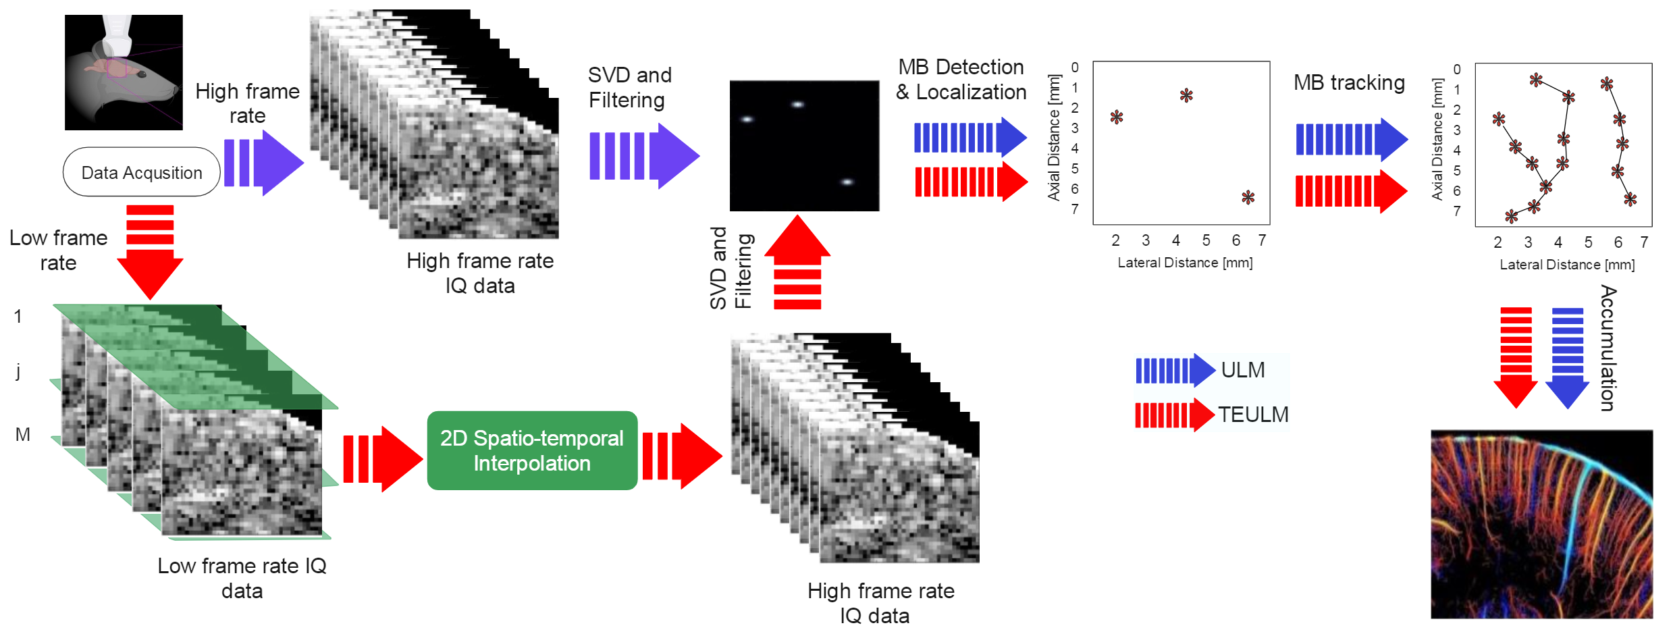
Pipeline Overview
What we need to implement:
Python interpolation with Matlab visualization
Notes:
首先来看一下整体的pipeline。

Slide 3
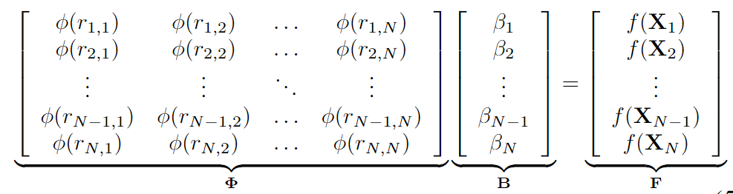


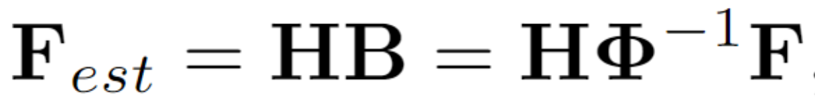
Spatio-temporal Interpolation
Construct phi matrix
Get interpolation weights B
Estimate data F_est
Keypoint:
How to make sure phi is invertible?
Choose kernel function & adjust hyperparameter !

Slide 4
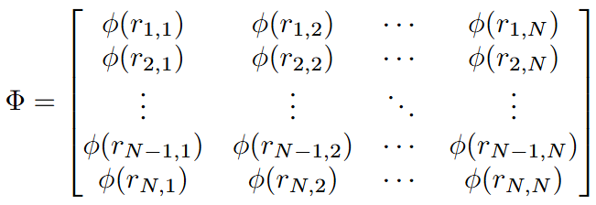
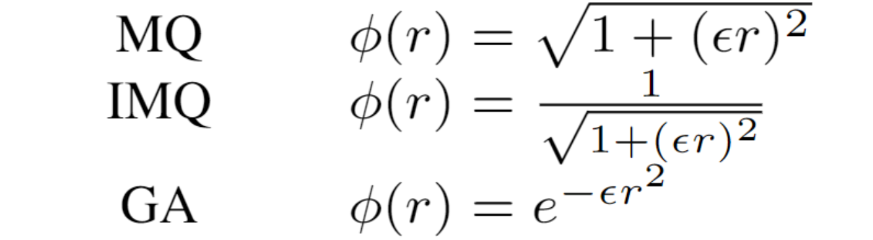
Different Radial Basis Function
Construct phi matrix
Get interpolation weights B
Estimate data F_est
RBF basis function
Unitilizing matrix calculation using torch and GPU!

Slide 5
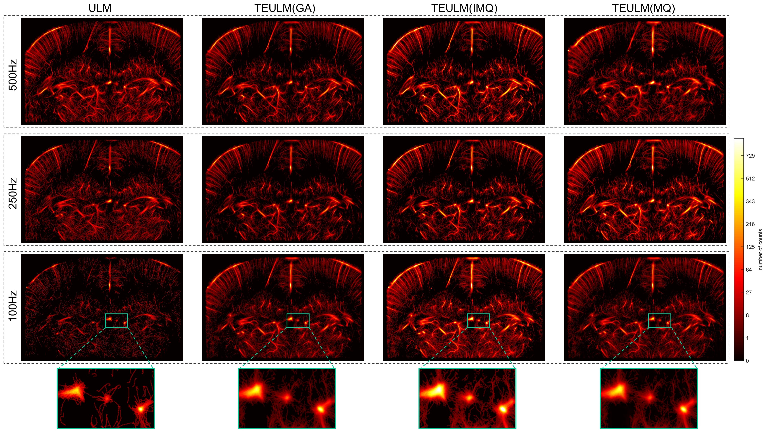
Reconstruction Results

Slide 6
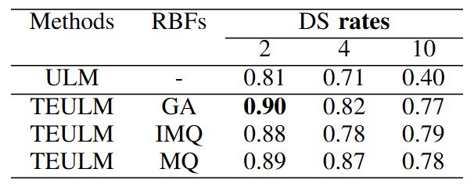

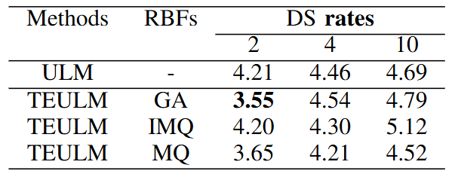

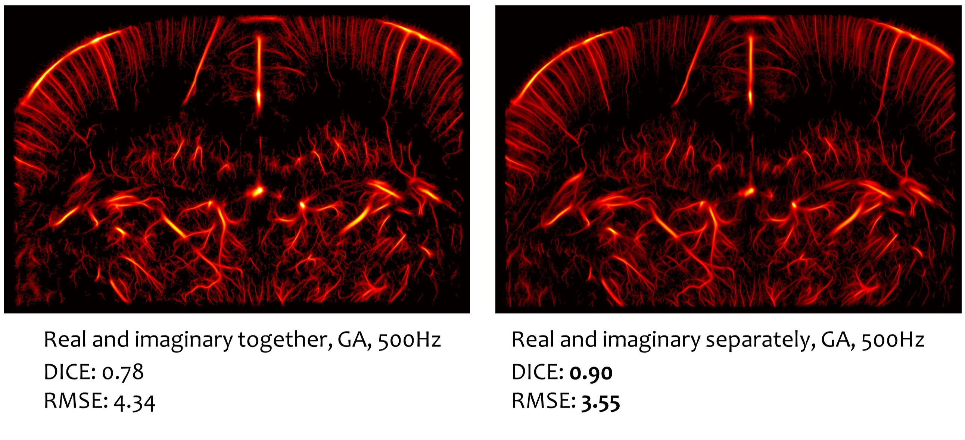
Experiment & Evaluation
Root Mean Square Error (RMSE)
the similarity between images measured pixel-by-pixel
DICE score
Evaluate similarity between images by measuring overlapping area of two images over the area of their union
Interpolation Method Ablation
Comparison between interpolation with real and imaginary together or separately

Slide 7
Q & A

